Slide 1
Waterfall Model
CaViTi’s Experience of River-rafting

Slide 2
Requirements
Identitfied Requirements
Expectations vs Reality of this stage

Slide 3
Our Requirements / Analysis
Resources Needed (stocking the boat) :
Computers
Competent Coders
Time
GitHub Group Repo
Objective (our destination):
To code a medium-complexity card game version of Karma to be utilized in a local setting for recreational purposes.
Mission Scenario(how our objective will be accomplished):
Segmentation of work and object-orientated programming.
Regular meetings for evaluation and quality-control.
Visualization: An appropriate GUI idea and implementation of the idea (most likely JavaFx).
A Schedule (planning the route):
A guide we can follow so as to monitor how our mission scenario is progressing.
Effectiveness:
Our program must be effective enough to work perfectly and efficient enough to be not be basic brute force implementation.

Slide 4
Expectations vs Reality of Requirements Stage
Expectations
Reality
Simple stage in which we discuss and get started.
Wouldn’t take much time.
A nice , clear complete plan for going forward.
Identification of requirements to be uncomplicated.
GitHub set up for group contribution and collaboration
We had no clue how to begin.
Our boat was stuck in mud.
It took longer than we anticipated to formulate a plan.
It wasn’t a difficult stage but we probably needn’t have spent so long at this stage.
We did end up with a proper plan (which would be upturned but more on that later).
GitHub was set up with no difficulty.

Slide 5
Design
Class Diagrams+Data Structures+Risk evaluation
Expectations vs Reality of this stage

Slide 6
Class Diagrams(Depicting data Structures)
Card
suit : int isFaceUp: boolean value: String + SPADES : int + DIAMONDS : int + HEARTS : int + CLUBS : int
+ card(int suit, String value, boolean isFaceUp) + compareTo(Card c): boolean + getSuit():String + getIndex():int + getValue():String + amIFaceUp(boolean wellAmI):void + isFaceUp():boolean + toString():String
Dealer
currentDeck: List<Card> discardDeck : List<Card> tableDeck : List<Card>
getShannon(List<Card> cards): double makeCards(): List<Card> + getDeckOfCards(): List<Card> + getCurrentDeck(): List<Card> + getTableCards() : List<Card> + getDiscardDeck() : List<Card> + riffleShuffle(int times, List<Card> cards): List<Card> + simpleShuffle(int times, List<Card> cards): List<Card> + clearPile() : void + intializeTableDeck() : void + showTopCard(): void
Player
name : String handCards : List<Card> tableCards : List<Card>
+ getHandCards() : List<Card> + getTableCards() : List<Card> + hasCards() : int + pickUp() : void + pickUpPile() : void + play(int i) : void + setCards(List<Card> handCards, List<Card> tableCards) : void + showMeYourCards() : void + toString(): String
Game
Players : Player [] endgame : Boolean currentPlayer : Player Scanner : Scanner gameLoopIndex : int playerIndex : int
+ gameLoop(Player p) : void

Slide 7
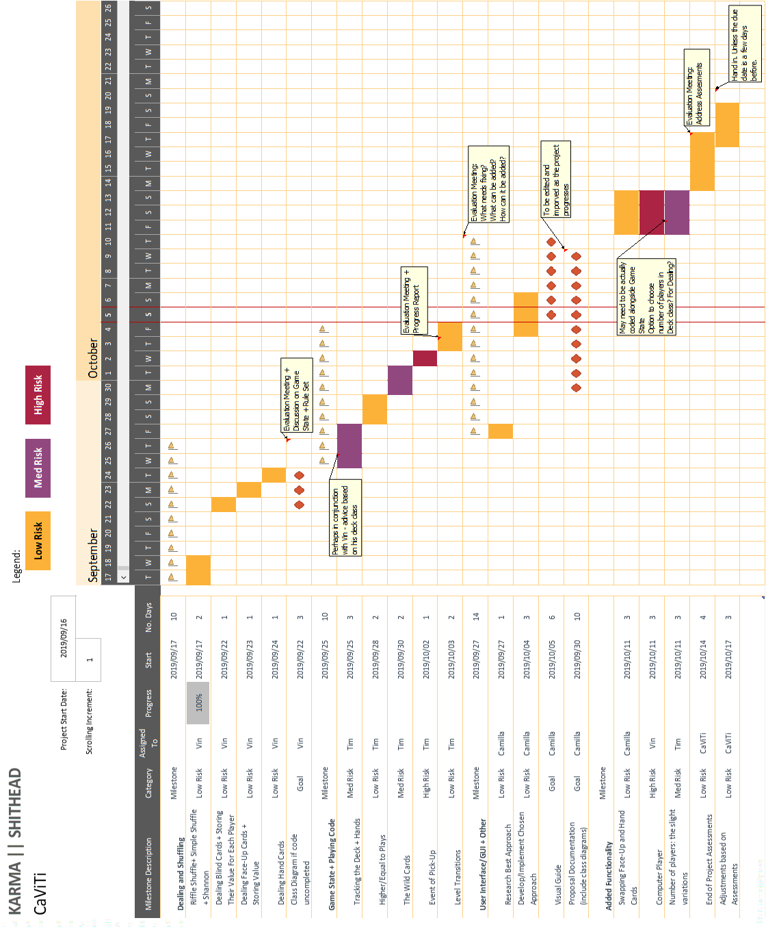
Risks, Time, Budget shown by Gantt chart

Slide 8
Expectations vs Reality of Design Stage
Expectations
Reality
Identification of data structures to go smoothly.
Class diagrams to be constructed in advance.
Risks to be identified as low, medium or high.
Time to be distributed evenly and fairly and logically.
Everything went according to our expectations. This is evident from the construction of the gantt chart which has essentially been designed to identify our milestones.
These were calm waters.
We took pictures of birds.
We had conversations with the river.
This was like a vacation.
Relaxation level 1000.

Slide 9
Implementation
Expectations vs Reality
Further disasters

Slide 10
Expectations vs Reality of implementation Stage
expectations
reality
Ample time to code, create GUI, evaluate project and add functionality like the computer player and the swap cards feature.
Relatively smooth source code writing since we had a thorough design stage.
Time to deliberate with our tutor and make modifications based on their advice.
Everything went wrong.
Everything.
The boat capsized.
We almost drowned.
The due date was announced to be a week before we had originally thought.
Our pleasant scenic boat ride became a cascading disaster.
There was no time to do the added functionality.
We struggled to confer with our tutor since we never had enough time to show.
The speed and ferocity of the river increased by 100.
We only just made it out alive.

Slide 11
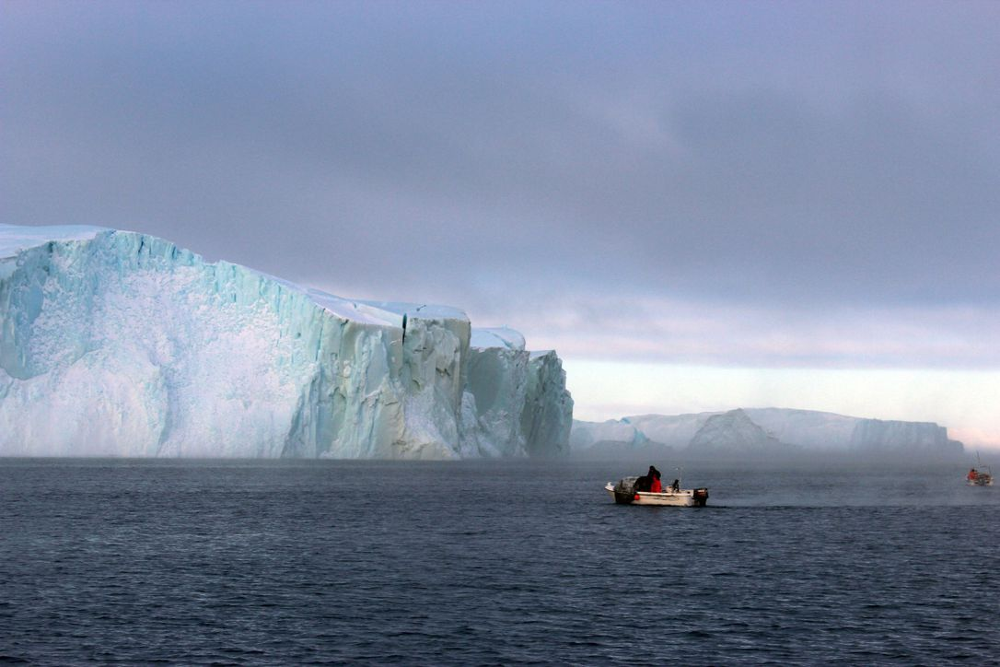
Further Disasters
The initial plan of JavaFX broke down. After Ca did extensive research on how to implement JavaFX and began to figure out how to visualize cards with drop-down choiceBoxes and layouts, the package was not available. We researched why and essentially tried everything. Downloaded java 8, 10, and the separate JavaFX package and it simply did not work. We had to scrap the JavaFX idea. We resolved to just make the outputs look as nice as possible in the command line (we did not like this solution either). We validated it, however, since we were confident we would have a working, efficient game.
And then.
All the code worked perfectly. Except for the gameLoop(). Essentially, we ran into an error that we could not figure out to fix. The error lay in the method of the list class that removed cards from the hand deck when a card is played. And several other places too.
JavaFX
Tim’s Code
Vin’s Code
JavaFX
Ti’s Code
Vi’s Code
Everything
CaViTi internally (and sometimes externally) screaming at all times

Slide 12
Epilogue
The unfortunate but hopeful conclusion to our horror of a river-rafting experiance

Slide 13
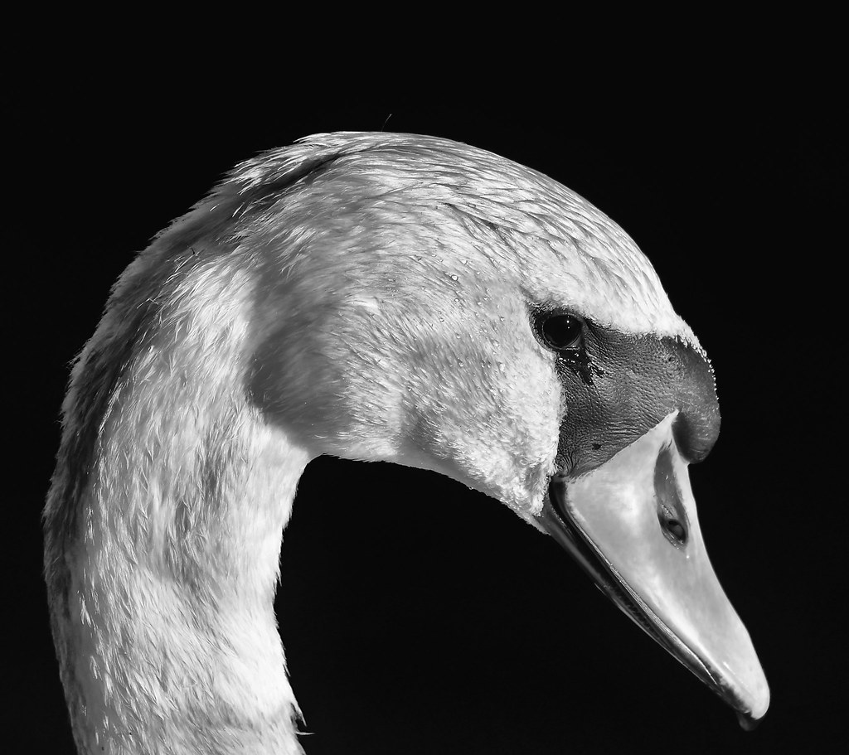
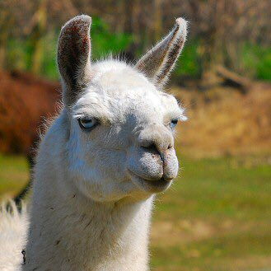
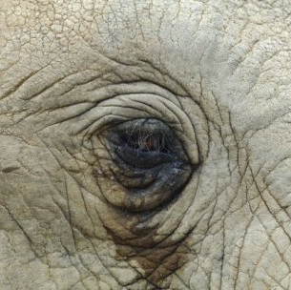
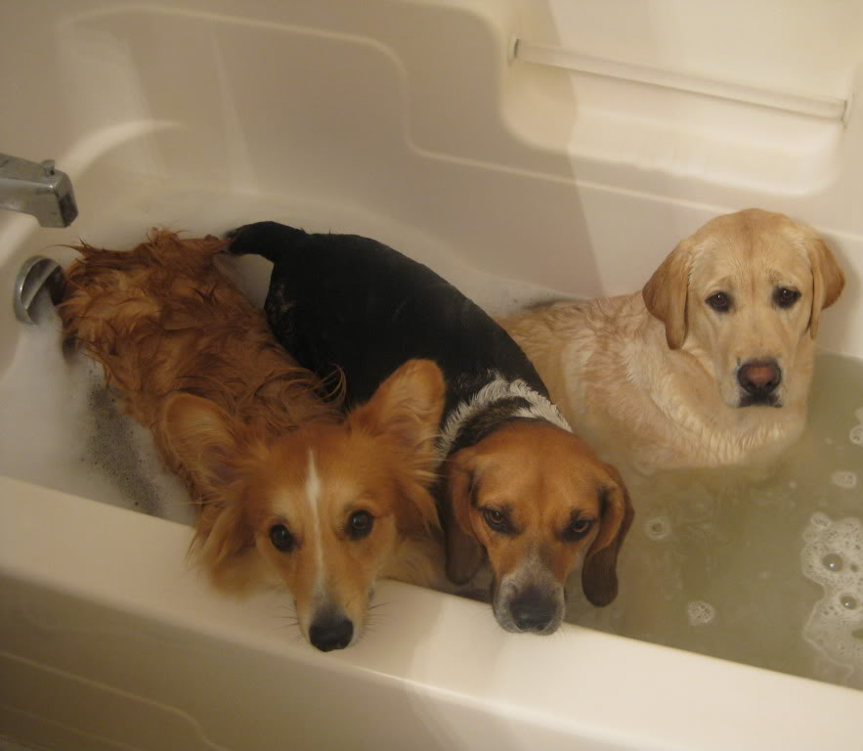
We are upset and exhausted
In the end, our boat capsized three times, we hit an iceberg (in a RIVER – like how is that even possible), almost drowned, got rescued by some pelicans, got dropped on a deserted island by those pelicans, had to live off the land for 3 months and finally made it back home with our misconceptions of coding a project of this magnitude fully corrected.
We did still have fun and we did still see the value in working on a project of this nature.
What we would do differently:
Started earlier: our schedule was off (since the due date was only announced a week and half before). Had we had a week/weekend extra, we would’ve had a fully working game. Even so, we should’ve started back in August.
Persevered with finding an appropriate GUI after our first option failed (again, time was needed for this).
Contacted our tutor and asked for advice.
Divided the code work far more evenly.

